Slide 1

Customer Shopping Behavior Analysis
Uncovering insights from 3,900 purchases to guide strategic business decisions.

Slide 2
PROJECT SCOPE
Data-Driven Strategy
Transactional Data
Key Insights
Goal
Analyzed 3,900 purchases across diverse product categories.
Uncovered spending patterns, customer segments, and product preferences.
Guide strategic decisions and future-proof business growth.

Slide 3
Dataset at a Glance
3,900
1
2
Demographics
Purchase Details
Total Rows
Age, Gender, Location, Subscription Status.
Item, Category, Amount, Season, Size, Color.
Purchases analyzed
18
3
Columns
Behavior
Features tracked
Discount, Promo Code, Previous Purchases, Review Rating.
Key features include demographics, purchase details, and shopping behavior.

Slide 4


Data Preparation in Python
Loading & Exploration
Imported dataset; checked structure and summary statistics.
Missing Data Handling
Imputed 37 missing Review Ratings using category median.
Feature Engineering
Created 'age_group' and 'purchase_frequency_days' columns.
Database Integration
Loaded cleaned data into PostgreSQL for SQL analysis.

Slide 5
SQL ANALYSIS: REVENUE & SPENDING
Key Financial Insights
Revenue by Gender
Shipping Type Comparison
Male customers generated significantly higher revenue.
Express shipping users have a higher average purchase amount.
Female
$75,191
Standard
$58.46
Male
$157,890
Express
$60.48
839 customers used discounts but still spent above average.

Slide 6
Product Performance & Discounts
Top 5 Products by Rating
Discount-Dependent Products
Gloves
Products with the highest percentage of discounted purchases:
Avg Rating: 3.86
50%
Sandals
Hat
Avg Rating: 3.84
49.66%
Boots
Sneakers
Avg Rating: 3.82
Hat
49.07%
Avg Rating: 3.80
Coat
Skirt
48.17%
Avg Rating: 3.78
Sweater
47.37%
Pants

Slide 7
CUSTOMER LIFECYCLE
Segmentation & Loyalty
Loyal
Returning
New
3,116 Customers
701 Customers
83 Customers
Repeat buyers (>5 purchases) are significantly more likely to subscribe (958 Yes vs. 2518 No).

Slide 8

Subscription Impact
Non-subscribers account for the majority of customers and total revenue.
Yes
1,053
$59.49
$62,645
No
2,847
$59.87
$170,436

Slide 9

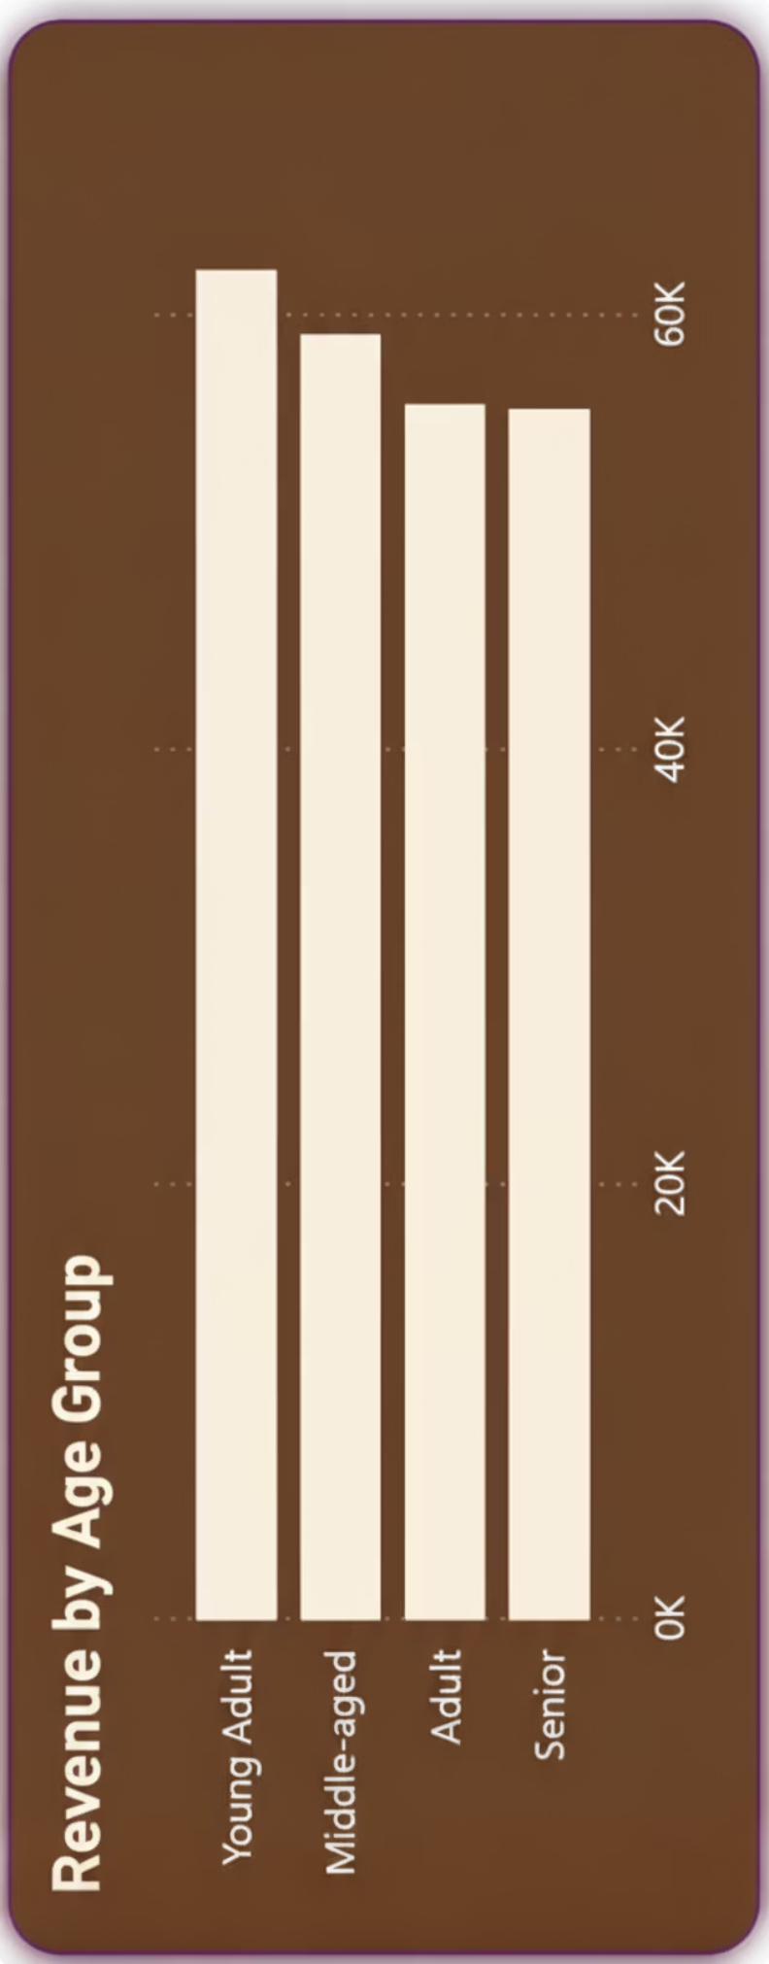
Revenue by Age Group
Young Adults and Middle-aged customers drive the highest revenue contribution.
Young Adult
$62,143
Middle-aged
$59,197
Adult
$55,978
Senior
$55,763

Slide 10
STRATEGIC IMPERATIVES
Business Recommendations
Boost Subscriptions
Promote exclusive benefits to increase sign-ups.
Customer Loyalty
Reward repeat buyers to grow the "Loyal" segment.
Targeted Marketing
Focus on high-revenue age groups and Express Shipping users.
Product Positioning
Highlight top-rated and best-selling products in campaigns.
Review Discount Policy
Balance sales boosts with margin control.

